Slide 1
Microsoft PowerPoint

Slide 2
The Elements of an Outstanding Presentation

Slide 3
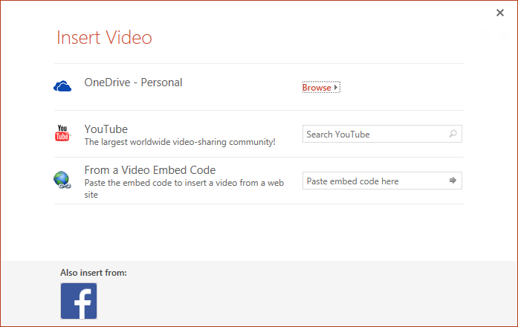

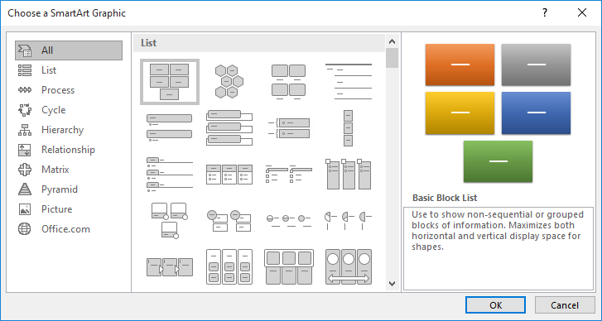
Check Out These Features!

Slide 4
Smith Training

